Slide 1
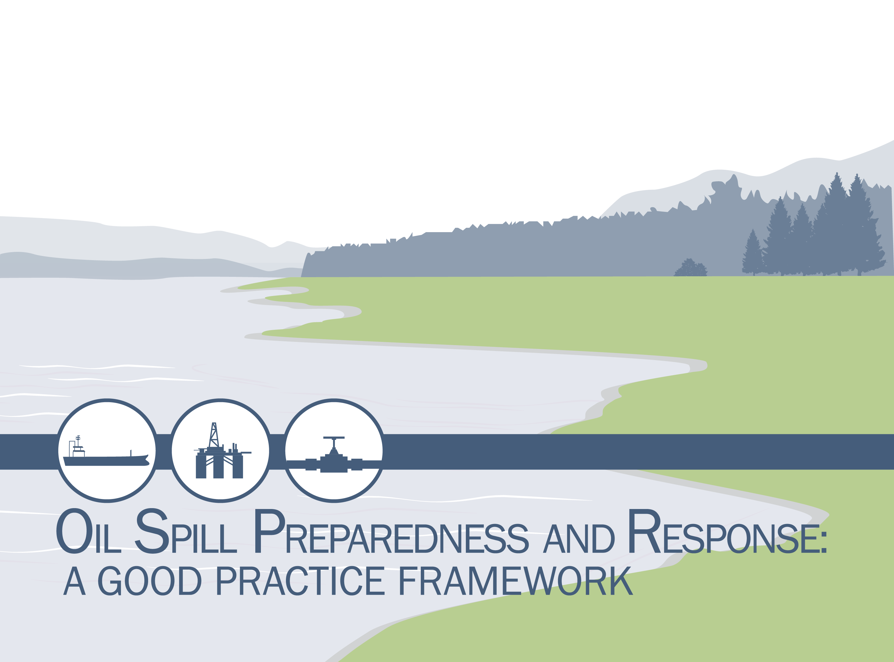
Notes:
Talking Points
Today we will discuss the industry’s overarching Oil Spill Preparedness and Response framework.

Slide 2
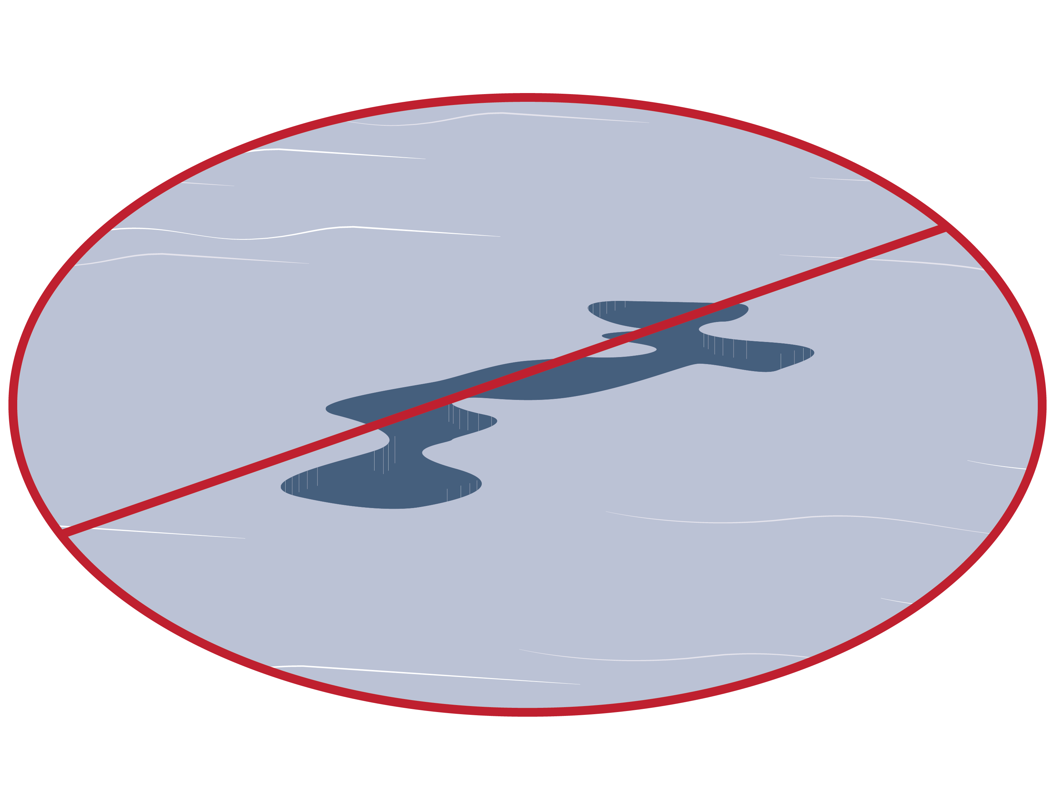
Preventing Oil Spills
Our goal is to never have an oil spill, and the industry takes extensive precautions to prevent spills from occurring.
Notes:
Talking Points
Our focus is prevention, and significant resources are dedicated to prevent a spill from occurring. Industry constantly incorporates new research, understanding, and lessons learned to improve spill prevention.
The number of large spill incidents (>700 tonnes) from tankers, combined carriers, and barges per decade has gone from 246 in the 1970s to 33 in the 2000s (Source: International Tanker Owners Pollution Federation (ITOPF)).
The amount of oil spilled from tankers, combined carriers, and barges has decreased from 3,218,000 tonnes in the 1970s to 212,000 tonnes in the 2000s (Source: ITOPF).
The average number of large spills (>700 tonnes) per year from tankers, combined carriers, and barges has decreased from 24.6 from 1970-1979 to 1.7 in 2010-2012 (Source: ITOPF).

Slide 3
Topics for Discussion
Why is effective Oil Spill Preparedness and Response so critical?
What makes the Oil Spill Preparedness and Response framework effective?
What are the components of the Oil Spill Preparedness and Response framework?
How can we support Oil Spill Preparedness and Response efforts?
Notes:
Talking Points
Our goal for the discussion today is to:
Explain why this framework is so critical to industry, governments, and communities;
Illustrate what makes the framework successful,
Describe the individual parts of the framework, and
Explain how we can work together to promote successful Oil Spill Preparedness and Response efforts.

Slide 4


Protecting Our Shared Values
  Through a robust Oil Spill Preparedness and Response framework, together we can achieve a more effective oil spill response to protect our shared values.
Sensitive Ecosystems
Local Businesses
Health and Safety
Tourism/Recreation
Community Industries
Notes:
Talking Points
In the rare event that an oil spill does occur, industry’s goal is to minimize the impact of the spill to people, environments, and communities, and to ensure a rapid and effective response.
Industry and government have a shared interest in a unified, coordinated, and proactive approach, as this allows us to protect our shared values, which include:
Sensitive ecosystems,
The local business community and economy,
The health and safety of our citizens, and
The vitality and sustainability of tourism and other key community industries such as fishing.

Slide 5
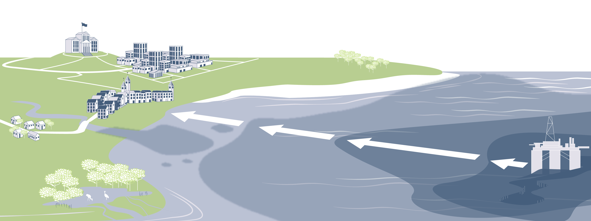
Combating the Spread of Spilled Oil
Our common enemy is the spread of spilled oil and its impact on our shared values – protecting them is a race against time.
The efficacy and speed of response are accelerated by:
Sharing objective information
Pre-approving response strategies
Rapid, nonpartisan decision-making
Mobilizing response capabilities
Notes:
Talking Points
Speed is a key element in oil spill response as an oil spill is an evolving event. An hour lost early in the response equates to days lost later in the process, and a spill’s impact on our shared values is exponentially proportional to the amount of time wasted before a response commences.
In order to promote a fast and effective response and, therefore, protect our shared values, industry needs:
Objective information,
Pre-approved response strategies,
Apolitical decision-making, and
The ability to mobilize response capabilities.

Slide 6
For successful oil spill response, we need proactive cooperation with governments and local communities, which consists of:
Cooperating for Effective Response
  Open lines of communication
  Transparent decision-making
  Clear policies regarding response techniques
  Realistic expectations of the response
Notes:
Talking Points
Cooperation with governments and communities is a necessity for our Oil Spill Preparedness and Response framework to be optimally effective.

Slide 7
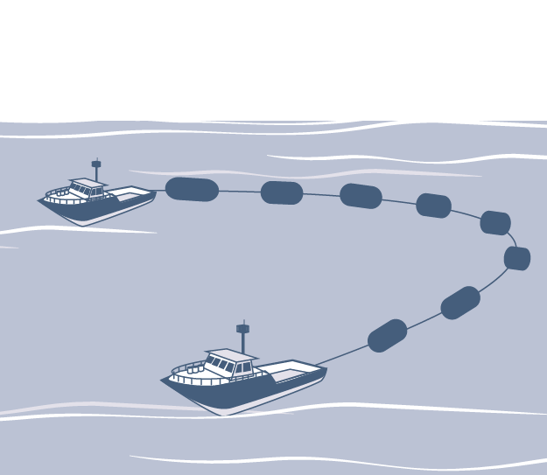



Our framework is made up of preparedness and response processes, with its foundation comprised of industry guiding principles, stakeholder engagement, and incident management.
Our Oil Spill Preparedness and Response Framework
Prevention
Restoration
Preparedness
Response
Notes:
Talking Points
Our framework was developed with the belief that a successful response depends on well-trained personnel working to a well-developed response strategy that is adequately resourced and properly exercised.
Our framework is comprised of defined, formal processes for efficient and effective preparation as well as rapid and successful response, should a spill occur. These two processes are built upon industry guiding principles, which support the protection of critical environmental and community assets. Also foundational to these processes are incident management, which organizes the response community, and stakeholder engagement, which promotes communication and transparency before, during, and after a spill.
While prevention and restoration are important operations and are linked to our Oil Spill Preparedness and Response framework, they are distinct and separate processes that will not be discussed in detail in this briefing.

Slide 8

Guiding Principles for Oil Spill Preparedness and Response
We follow a set of guiding principles that allows the response community to achieve a rapid, well-managed, and unified response effort:
Protect the safety and health of people
Stop the source of a spill as quickly as possible
Minimize environmental and community impact
Minimize oil getting to shore in offshore scenarios
Minimize oil getting into water in onshore scenarios
Stakeholder Engagement with Governments, Communities, and Industry
Notes:
Talking Points
To achieve a rapid and effective response, there are several guiding principles that industry follows. These principles are meant to support the protection of our most critical environmental and community assets.
Our guiding principles include:
We prioritize the safety and the health of people,
We stop the source of a spill as quickly as possible,
We minimize environmental and community impact,
We minimize oil getting to shore in offshore scenarios, and
We minimize oil getting into the water in onshore scenarios.

Slide 9
Stakeholder Engagement
Stakeholder engagement with governments and communities is essential before, during, and after a spill, and includes:
  Three-way communication between industry, government, and the community
  Understanding of stakeholder priorities
  A shared view of the situation
  Transparency of decision-making
  Collaboration within an incident management system
Notes:
Talking Points
Engaging with governments and communities is vital during the preparedness and response processes and encourages communication and transparency across all parties. This engagement communicates the lengths industry goes to prepare for the unlikely event of a spill and the policies and procedures in place in order to effectively respond. In communicating these steps taken with all stakeholders, industry adheres to the mantra of “inform, consult, and listen”.
Three-way communication includes established points of contact for industry, government, and the community. Understanding of stakeholder priorities and a shared view of the situation ensure that all parties are operating from the same perspective. Transparency of decision-making means all parties are privy to the choices being made, and collaboration within an incident management system ensures that stakeholder engagement is integrated into the management of response operations.
For stakeholder engagement to be successful, a consistent industry message is key.

Slide 10
Incident Management
  An incident management system organizes the response community to work together, make decisions, and respond rapidly and effectively.
  Typical Incident Management Structure
  An incident management system provides:
  Organizational structure
  Defined roles and responsibilities
  Clear decision-making and response processes
  Communication between responders and impacted communities
  Common understanding and situational awareness
  Implementation of response
  Incident Command
  External Stakeholder Liaison
  Planning
  Operations
Logistics
  Finance and Admin
Notes:
Talking Points
An incident management system defines and standardizes the strategies and processes of the response community in order to promote successful management of response operations to rapidly and effectively respond to a spill. Pictured is a typical incident management structure. However, slight variations are found from country to country.
The following forcing questions are used to clarify key features of the working relationship between the responding organization, government regulators, and other stakeholders:
What is the response process?
What are the specific roles and responsibilities of involved parties?
Who has the decision-making power?
What is the decision-making process?
What is the state’s capability to implement?
What is the effectiveness of that capability?
What is the stake and commitment level of regulators?

Slide 11
Preparing for Response
Our detailed contingency planning and preparedness process is made up of the following core components:
Identify Potential
Events
Plan Scenarios
Develop Response
Strategies
Provision Resources
This is a scalable process that can apply to one facility or multiple operations across an entire geographic region.
Notes:
Talking Points
Our contingency planning and preparedness process allows us to identify and plan for spills of any magnitude. Incorporated within this process are training and exercises, as well as the principles of Tiered Preparedness and Response, which enable the industry to appropriately provision resources to facilities or regions to enable response escalation based on prior planning. Industry believes that a well-prepared and well-practiced response strategy significantly increases the likelihood of an effective response operation.
The preparedness process consists of the following steps:
Identify Potential Events: Identify potential events for a specific facility or region.
Plan Scenarios: Develop planning scenarios based on the previously identified events that encompass the full range of impact and response challenges for a specific facility or region.
Develop Response Strategies: Develop appropriate response strategies based on the planning scenarios.
Provision Resources: Provision resources according to the response strategies using the principles of Tiered Preparedness and Response.

Slide 12





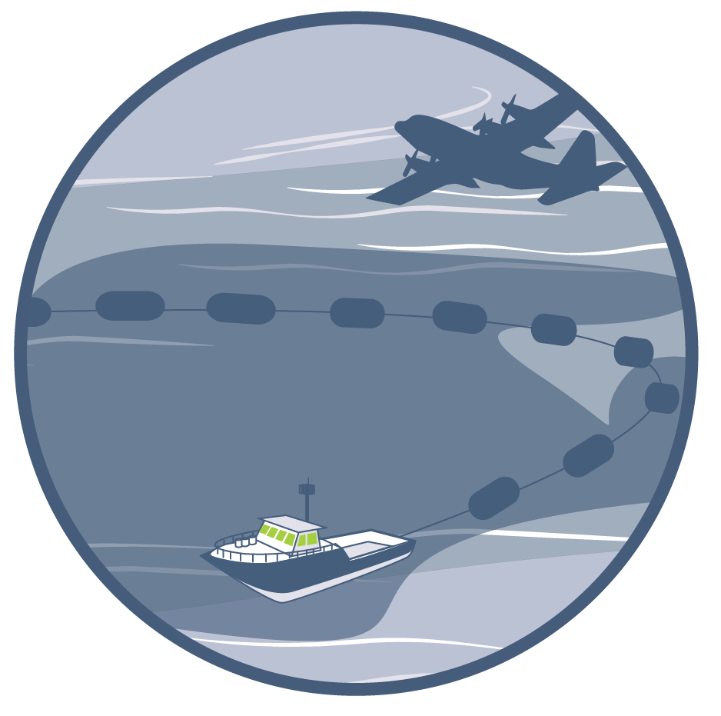
Responding to an Incident
Through the following process, industry mobilizes resources according to a formal, pre-planned strategy and adapts the response as the event unfolds:
Initial Deployment
Confirm Response Strategy
Organize Response
Cascade Resources
Adjust for Realities
Ongoing Response
Notes:
Talking Points
Our formal response process, based on planning from the preparedness phase, allows industry to organize and mobilize resources quickly and efficiently in order to effectively respond to a spill. Our process includes:
Initial Deployment: Following a spill, responders immediately deploy all local response resources and assess the scale and impact potential of the event.
Confirm Response Strategy: Responders then match the actual spill to the closest planning scenario. Once matched, the accompanying pre-planned response strategy is confirmed as appropriate and implemented.
Organize Response: Organizing the response entails procuring the appropriate resources to allow for the industry standard of prudent overreaction. This also includes the stand-up and implementation of an incident management system.
Cascade Resources: Resources are deployed in a cascading manner, which enables response escalation by pulling in appropriate external resources as the spill evolves and responders understand what is required.
Adjust for Realities: Strategy effectiveness and incident conditions are assessed and adjusted for throughout the response.
Ongoing Response: The response will continue until an agreed-upon endpoint is reached, at which time restoration will commence.
This process, after “Initial Deployment”, is often cyclical. Based on the operational period, there may be a repeating process of “plan, do, re-evaluate, and adapt”.

Slide 13
Restoring Impacted Areas
  Restoration consists of environmental and community rehabilitation to agreed-upon endpoints.
  The goal of restoration is to return the impacted area to
  pre-spill use.
Notes:
Talking Points
While distinct and separate from the Oil Spill Preparedness and Response framework, restoration plays a key role following a spill. Components of restoration may include:
Environmental Restoration: The goal of environmental restoration is to restore the environment to pre-spill use through natural recovery or restoration activities, such as marsh vegetation planting, sediment replacement, habitat enhancement, etc.
Community Restoration: Compensation of financial impacts is one form of community restoration, along with advertising campaigns to promote local businesses, tourism and recreation, and enhanced access to recreational shorelines.

Slide 14
Request of Stakeholders
For successful implementation of the Oil Spill Preparedness and Response framework – and to effectively protect our shared values – we request the following of government and community stakeholders:
  Pre-approve response strategies
  Help overcome barriers during a response
  Leverage industry expertise as we work together
Notes:
Talking Points
To optimize industry’s Oil Spill Preparedness and Response framework, in order to protect our shared values, there are certain requests we ask of governments and communities:
Pre-approve response strategies in order to respond to a spill as rapidly and effectively as possible.
Help overcome barriers during a response through:
Rapid, nonpartisan decision-making,
Sharing of objective information, and
Mobilizing of response capabilities to include the expedition of the cross-border transfers of people and equipment.
Leverage our expertise before, during, and after a spill through:
Clearly predefined roles and responsibilities, and
The designation of operational authority only to appropriate response parties – thus removing distractions.

Slide 15
Summary
The Oil Spill Preparedness and Response framework allows the response community to appropriately plan for and rapidly respond to minimize the spread of spilled oil and the resulting impacts on our shared values.
Sensitive Ecosystems
Local Businesses
Health and Safety
Tourism/Recreation
Community Industries
Notes:
Talking Points
Industry’s Oil Spill Preparedness and Response framework allows us to plan for and respond to oil spills in their unlikely event in order to protect our shared values. The effectiveness of our framework is maximized through cooperation with governments and communities before, during, and after spills.

Slide 16
Appendix
Notes:
NOTE TO PRESENTER: Content in the Appendix is intended to be used as needed to supplement the primary slides or stand alone as a handout based on the intended outcome or audience.

Slide 17
Our Oil Spill Preparedness Process
Preparedness
Perform Training and Exercises
Identify Potential Events
Plan Scenarios
Develop Response Strategies
Provision Resources
Stakeholder Engagement with Governments, Communities, and Industry
Notes:
Talking Points
We will now take a more in-depth look at our contingency planning and preparedness process.

Slide 18




Preparedness: Identify Potential Events
Identify Potential Events
Responders define potential oil spill risks.
Identify Potential Events:
Improve Prevention:
Responders identify potential events and their likelihood for the specific site, up to and including the credible worst case.
Through the identification of potential events, responders may identify and implement further prevention measures that will reduce the chance of spills.
Notes:
Talking Points
The first step in preparedness is for responders to identity the potential events for a specific facility or region, including worst case events.

Slide 19

Preparedness: Plan Scenarios
Plan Scenarios
Using the identified events, responders define appropriate spill planning scenarios.
Planning Scenarios:
Scenario Characteristics:
Responders select the events that encompass the full range of impact and response challenges for the specific site in order to develop planning scenarios.
Each planning scenario includes:
Event
Oil type and volume
Spill profile
Predicted behavior of spill and fate of oil
Impacted environments and communities
Notes:
Talking Points
Responders then select the events that cover the full range of impacts and response challenges for that specific site and develop planning scenarios based on those events. These scenarios are built out to include characteristics such as the predicted behavior of the spill and the potentially impacted resources.

Slide 20

Preparedness: Develop Response Strategies
Develop Response Strategies
Responders develop response strategies based on the planning scenarios.
Response Strategy:
Net Environmental Benefit Analysis (NEBA):
Response strategies are developed for each planning scenario and incorporate stakeholder engagement. Response strategies address the following questions:
What techniques are needed?
How much of each technique is needed?
What is the response timeframe?
How will the response adapt over time?
The response strategies are underpinned by NEBA, which is conducted during the preparedness process to identify the best choices that minimize impacts of oil spills on people and the environment. Other considerations of the response strategies include applicable regulations and the effectiveness and feasibility of involved techniques.
Notes:
Talking Points
After building out the planning scenarios, responders develop response strategies to identify how best to respond to the each potential scenario. These strategies are developed using NEBA, among other considerations, to identify the best choices that minimize impacts of spills on people and the environment.

Slide 21

Preparedness: Provision Resources
Provision Resources
Industry members provision resources appropriate to the pre-planned response strategies using the principles of Tiered Preparedness and Response.
Tiered Preparedness and Response:
Industry Resources:
  Responders use the principles of Tiered Preparedness and Response to categorize and structure levels of oil spill response capabilities to allow for response escalation.
  Resources are provisioned, according to the response plan, at varying levels based on spill scenario requirements and how quickly resources will be needed and can be accessed. These principles enable responders to plan for appropriate regional and global resources to be mobilized rapidly and cascaded for an effective response to a spill of any magnitude.
Industry members provision the following response resources during the preparedness process:
Responders
General equipment
Specialized tools and services
Subject matter expertise
Mutual Aid and Cooperation:
  Industry members may enter into mutual aid or cooperative agreements with other local members to bolster their own capabilities through the sharing of industry resources.
Notes:
Talking Points
After developing response strategies, resource provisioning occurs using the principles of Tiered Preparedness and Response. This process ensures that facilities or regions have access to the appropriate response resources as determined by prior planning. The principles of Tiered Preparedness and Response allow for response escalation and reduce the over-proliferation of response resources through the integration of regional and global response capabilities.

Slide 22
Preparedness: Training and Exercises
Training and Exercises
Industry members participate in and lead training and exercise activities, ensuring response staff are prepared for a variety of spill scenarios.
Training:
Participants:
Staff are trained in accordance with their response plan and in their designated roles for spill response activities.
Typical training and exercise participants include:
Spill management team
Field responders
Regulators
Stakeholders
Exercises:
Continual Process:
  Exercises enable participants to work together in conducting simulated responses to hypothetical incidents in order to demonstrate proficiency and validity of response plans.
  Types of exercises include:
Discussion-based (table top) exercises
Notification and communication tests
Equipment deployment
Full scale exercises
Training and exercises occur throughout the preparedness process.
Notes:
Talking Points
Training and exercises occur throughout the preparedness process and bring together spill response stakeholders, such as government and industry, to train and practice using simulated scenarios.

Slide 23
Preparedness: Summary
Our preparedness process allows industry to plan for location-specific potential scenarios, enabling a rapid and effective response in the event of an incident.
Preparedness
Perform Training and Exercises
Identify Potential Events
Plan Scenarios
Develop Response Strategies
Provision Resources
Stakeholder Engagement with Governments, Communities, and Industry
Notes:
Talking Points
Our thorough contingency planning and preparedness process is what enables industry to rapidly and effectively respond in the unlikely event of an incident.

Slide 24
Our Oil Spill Response Process
Response
Initial Deployment
Confirm Response Strategy
Organize Response
Cascade Resources
Adjust for Realities
Ongoing Response
Stakeholder Engagement with Governments, Communities, and Industry
Notes:
Talking Points
We will now take a more in-depth look at our response process.
It is essential to note throughout the response process the importance of time. For a successful response, there is a critical “window of opportunity”, after which response effectiveness may be compromised.

Slide 25
Response: Initial Deployment
Initial Deployment
When a spill occurs, responders immediately deploy local resources and assess the incident potential.
Initial Deployment:
Alerts and Notifications:
  Following a spill, local resources are immediately deployed to mitigate initial impacts, reduce the spread of oil, and protect the safety of people.
  Appropriate stakeholders, such as government regulators and community leaders, receive alerts and notifications immediately following a spill, initiating their engagement with the specific incident.
Initial Assessment and Classification:
Importance of Time:
  Responders assess the incident scale and impact potential in parallel with the initial deployment.
  In many responses, there is a critical “window of opportunity”, after which the oil spreads to very miniscule thicknesses that may compromise response effectiveness. Time is of the essence and, therefore, pre-approval of response strategies is essential.
Notes:
Talking Points
When a spill occurs, the response is initiated by immediate deployment of local resources and assessment of incident scale and impact potential.

Slide 26
Response: Confirm Response Strategy
Confirm Response Strategy
Following the initial deployment, the actual spill is matched to the planning scenarios and the accompanying response strategy is confirmed.
Match to Scenarios:
Net Environmental Benefit Analysis (NEBA):
  Responders match the actual spill to the closest planning scenario.
  The choices made during the preparedness process, based on NEBA, are validated once a spill has occurred. These choices confirm the selection of the best available response options that minimize impacts of the oil spill on people and the environment.
Confirm Response Strategy:
Adapt by Exception:
  After matching the spill, responders confirm applicability of the corresponding pre-planned response strategy and initiate its implementation. This ensures utilization of the most effective response techniques from the outset.
  The pre-planned response strategy is adapted only by exception, taking into account any unforeseen factors and the evolution of the spill.
Notes:
Talking Points
After initial deployment, responders match the actual spill to the planning scenarios and corresponding response strategies developed during the preparedness process. Once the spill is matched to a scenario, responders will implement the corresponding response strategy, using “the biggest hammer in the toolbox first”.

Slide 27
Response: Organize Response
Organize Response
The response is organized to allow for prudent overreaction and the implementation of an incident management system.
Organize Response:
Incident Management System:
  Organizing the response entails procuring the appropriate resources, including the establishment of an appropriately sized spill management team, that allow for prudent overreaction to the incident commensurate with risks and requirements. It is important to note, however, that unnecessary response measures can further damage the environment.
  Incident management systems define and standardize roles and responsibilities, communication lines, management strategies, processes, and terminology across governmental organizations and industry, enabling timely stand-up and effective management of response operations in the event of a spill.
Keys to Successful Incident Management:
  Maintain clear incident response objectives and tactical actions
  Adopt a daily incident management routine and process
  Monitor deployed resources to ensure their applicability and effectiveness
  Foster collaborative and open working relationships among stakeholders
Notes:
Talking Points
Once a response strategy has been selected, responders will organize the response by procuring the appropriate resources and standing up an incident management system.

Slide 28

Response: Cascade Resources
Cascade Resources
Appropriate response resources are deployed to the incident location.
Cascading Resources:
Resource Types:
  Resources are deployed in a cascading manner to the incident location, per the predetermined response strategy. The cascading process involves resources mobilizing to the incident location as the spill evolves and responders better understand what equipment and services are required.
  Resources deployed to the incident location may include local resources, mutual aid, oil spill response organizations, and state authorities.
Each bar represents a specific response capability for a facility or region and the colored bars represent the appropriate capabilities for a specific spill.
Notes:
Talking Points
Resources will then cascade to the incident location in a phased manner as responders better understand what resources are required.

Slide 29
Response: Adjust for Realities
Adjust for Realities
During a response, strategy effectiveness – as well as incident conditions and circumstances – must be evaluated and analyzed in order to successfully adapt the response approach.
Variance from the Plan:
Net Environmental Benefit Analysis (NEBA):
  Because a responder cannot predict all conditions related to a planning scenario, the response is adjusted to reflect realities of the situation, including:
  Actual vs. forecasted operating conditions
  External restrictions to response
  Safety and security
  Stakeholder reactions
  Unrealistic expectations
  During the response, the NEBA process is used to regularly re-evaluate the response strategy, taking the realities of the situation into account. Following re-evaluation, the effectiveness and feasibility of response options are confirmed and the best available response option that minimizes the impact of the spill on people and the environment is implemented.
Notes:
Talking Points
Throughout the process, the response will be evaluated and adapted based on changing circumstances.

Slide 30
Response: Ongoing Response
Ongoing Response
The ongoing response represents the continued response effort and transition to restoration.
Ongoing Response:
Realities of a Response:
  The ongoing response will be continually adapted until a determined endpoint has been reached in agreement with stakeholders. This endpoint is determined by:
  NEBA criteria
  Whether further response is environmentally detrimental or becomes increasingly ineffective
  Addressing community needs
  With human health and safety as our first priority, a response may not be safe or possible in all locations.
  Not all oil can be recovered and sometimes cleanup efforts can cause more harm than good.
  Monitoring natural processes and transitioning to restoration measures can, at times, be the best option.
Transition to Restoration:
  Upon completion of the response effort, restoration activities may commence, including:
  Environmental and community restoration
  Conducting long-term studies and projects
  Continued dialogue between industry and authorities
Notes:
Talking Points
The response will continue until an agreed-upon endpoint, at which time restoration may commence.
It is important to note that as human health and safety is our first priority, certain response measures may be limited in specific situations.

Slide 31
Response: Summary
Our Response process allows us to respond rapidly and effectively to an incident while continually evaluating and modifying the response in order to address changing conditions, until an agreed-upon endpoint is reached.
Response
Initial Deployment
Confirm Response Strategy
Organize Response
Cascade Resources
Adjust for Realities
Ongoing Response
Stakeholder Engagement with Governments, Communities, and Industry
Notes:
Talking Points
Our response process allows industry to rapidly and effectively respond to an incident based on planning scenarios and predetermined response strategies. This process also allows industry to continually evaluate and adapt the response in order to pursue the most effective response possible.

