Slide 1
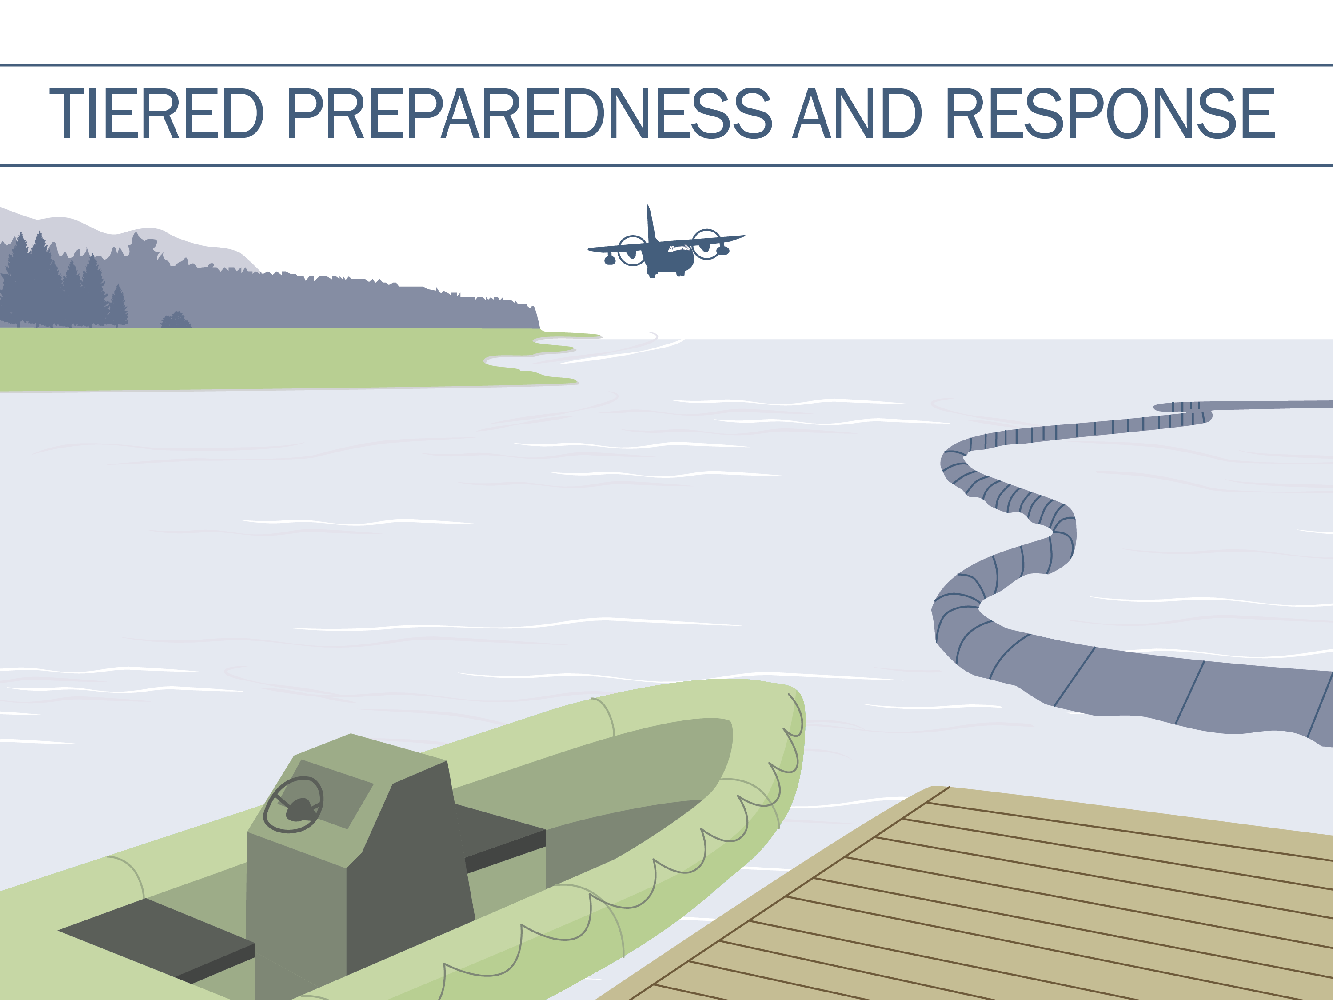
Notes:
Talking Points
Today we will discuss industry’s principles of Tiered Preparedness and Response.

Slide 2
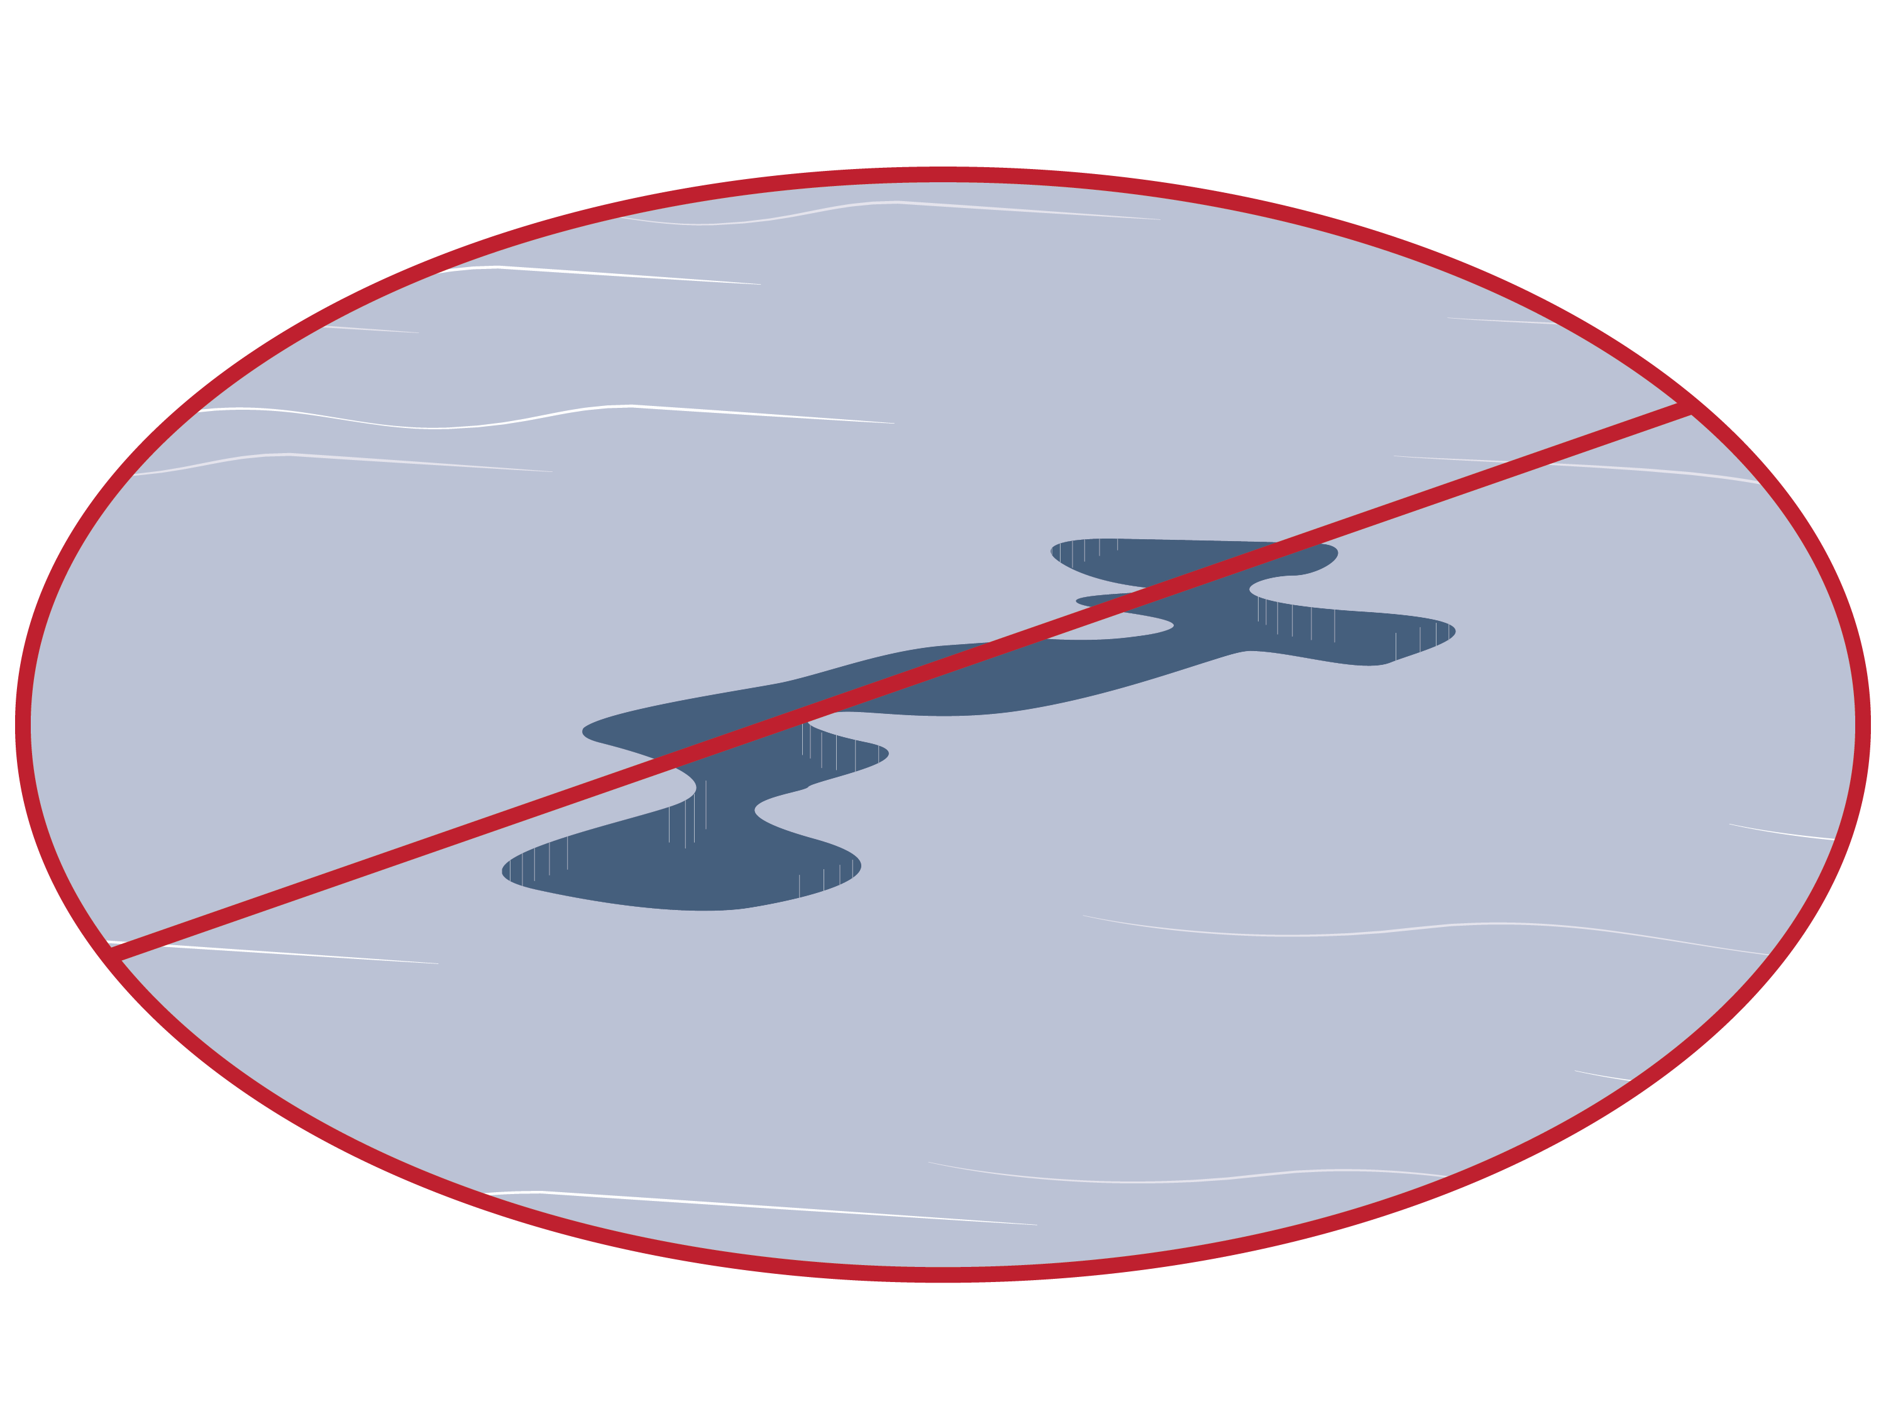
Preventing Oil Spills
Our goal is to never have an oil spill, and industry takes extensive precautions to prevent spills from occurring.
Notes:
Talking Points
Our focus is prevention, and significant resources are dedicated to prevent a spill from occurring. Industry constantly incorporates new research, understanding, and lessons learned to improve spill prevention.
The number of large spill incidents (>700 tonnes) from tankers, combined carriers, and barges per decade has gone from 246 in the 1970s to 33 in the 2000s (Source: International Tanker Owners Pollution Federation (ITOPF)).
The amount of oil spilled from tankers, combined carriers, and barges has decreased from 3,218,000 tonnes in the 1970s to 212,000 tonnes in the 2000s (Source: ITOPF).
The average number of large spills (>700 tonnes) per year from tankers, combined carriers, and barges has decreased from 24.6 from 1970-1979 to 1.7 in 2010-2012 (Source: ITOPF).

Slide 3
Topics for Discussion
What is Tiered Preparedness and Response?
Why is Tiered Preparedness and Response used?
How has Tiered Preparedness and Response evolved?
What are the components of Tiered Preparedness and Response?
Notes:
Talking Points
Our goal for the discussion today is to:
Explain the principles of Tiered Preparedness and Response,
Illustrate why it is used,
Explain how the model has evolved, and
Describe the individual components of Tiered Preparedness and Response.

Slide 4
What is Tiered Preparedness and Response?
  Tiered Preparedness and Response is an internationally recognized planning approach used to:
  Define and structure levels of oil spill response capabilities; this approach is not used to categorize the size or scope of a spill
  Plan for appropriate resources to be rapidly mobilized and cascaded to an incident location
  Enable response escalation for an oil spill of any magnitude
  The following resources are considered when using Tiered Preparedness and Response:
Responders
Equipment
Additional Support
Notes:
Talking Points
Developed in the 1980s, Tiered Preparedness and Response categorizes response capabilities and ensures that the appropriate resources are accessible to a facility or region should an incident occur. These principles allow responders to incorporate industry’s regional and global resources into response escalation planning when preparing for the unlikely event of a spill.

Slide 5
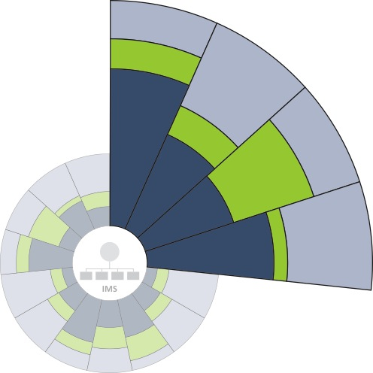
Defining the Tiers
  The tiers represent the various levels of resource capacity required to respond to a specific facility or region, and do not represent quantitative measurements of capacity
Tier 1: Resources necessary to handle a local spill and/or provide an initial response
Tier 3
Tier 2
Tier 2: National or regional resources necessary to supplement a Tier 1 response
Tier 1
Tier 3: Global resources necessary for spills that require a substantial additional response due to incident scale, complexity, and/or impact potential
Each wedge represents a different response capability and is subdivided to illustrate that the available/required resources for each tier will generally differ between capabilities but can be combined to provide the needed capacity for each response capability.
Notes:
Talking Points
Each wedge represents a type of response capability, while each tier represents the capacity of the response capability required to respond to a spill for a specific facility or region.
“Accessible” does not necessarily imply on-site resources. Tier 1 resources will generally be located on-site; Tier 2 and 3 resources will be off-site but available in the event of a spill that requires these capabilities.
The tiers cannot be defined quantitatively. There are too many complex variables (e.g., location, weather, local governance, etc.) in a spill to calculate the amount and quantity of resources required solely by the volume of oil spilled.

Slide 6
Tiered Preparedness and Response Model
Each wedge represents a specific type of response capability, e.g. surface use of dispersants.
Incident Management System
operations section
planning section
logistics section
finance/
admin section
The incident management system (ims) symbol is at the center of the model to indicate that incident management is a central consideration when planning for potential incidents using the Tiered Preparedness and Response approach.
Note: The model shows example levels of tiered capacity for each response capability – actual levels are determined on a case-by-case basis for each facility or region.

Slide 7
Capabilities of Tiered Preparedness and Response
  The following 15 capabilities essentially represent the scope of Tiered Preparedness and Response:
  *Source Control
  Surveillance, Modeling, and Visualization
  *Environmental Impact Assessment (incl. Sampling)
  Offshore Surface Dispersants
  *Economic Assessment and Compensation
  Offshore Subsea Dispersants
  *Stakeholder Engagement and Communication
  In-situ Controlled Burning
  *Waste Management
  At-sea Containment and Recovery
  Oiled Wildlife Response
  Protection of Sensitive Resources
  Inland Response
  Shoreline and Inland Assessment (SCAT)
  Shoreline Cleanup
*These capabilities may not be provided by oil spill response organizations or mutual aid, but must be considered by operators in planning. Operators must combine internal and external resources to meet the capability required to respond to potential incidents.
Notes:
Talking Points
The 14 capabilities essentially represent the scope of Tiered Preparedness and Response, however, they can be broken out in a variety of ways.

Slide 8
Why is Tiered Preparedness and Response Used?
  Tiered Preparedness and Response enables:
  Integration of local, regional, and global industry capabilities into oil spill response planning
  Industry’s ability to efficiently respond to an oil spill of any magnitude without maintaining the entire range of response resources at each operating facility or within each country
Notes:
Talking Points
Through the sharing of industry capabilities, the principles of Tiered Preparedness and Response reduce the unnecessary over-proliferation of response resources across the globe, while still enabling a rapid and effective response to a spill of any magnitude.

Slide 9
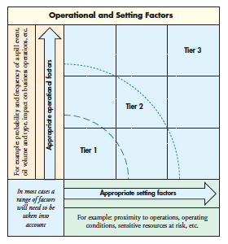
How has Tiered Preparedness and Response Evolved?
  As response equipment and services have evolved to become more specialized, so too must the Tiered Preparedness and Response model
  Modern technology, advanced logistics capabilities, and new communication tools have improved industry’s ability to cascade resources to an incident location.
  The benefits of today’s specialization and expertise are diminished if they must be replicated at each operating site or within each country.
  The model facilitates a tiered response by depicting which response capabilities are needed and in what timeframe.
Evolving Model
Notes:
Talking Points
With the specialized nature of today’s equipment and services, as well as the variable location of operations, spills and their associated responses can no longer be classified based on volume. The Tiered Preparedness and Response model has evolved to reflect the realities of today’s operational environment.

Slide 10
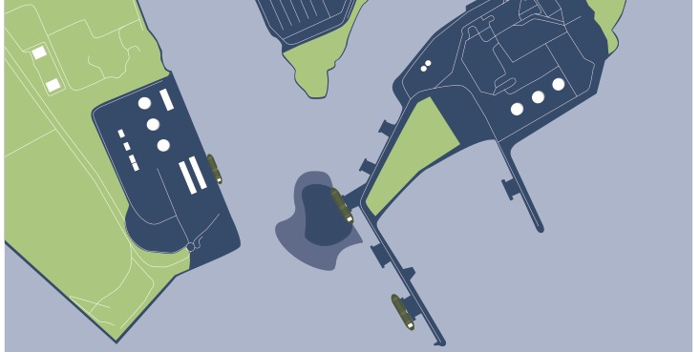
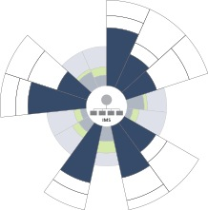
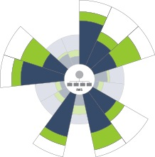
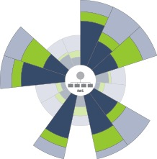
Examples of Cascading Resources
Tier 1:
Tier 2:
Tier 3:
Resources necessary to handle a local spill and/or provide an initial response
National or regional resources necessary to supplement a Tier 1 response
Global resources necessary for spills that require a substantial additional response due to incident scale, complexity, and/or impact potential
Notes:
Talking Points
The graphic depicts an example of the result of tiered planning. Resources strategically placed around the globe will cascade to an incident location according to the principles of Tiered Preparedness and Response.

Slide 11
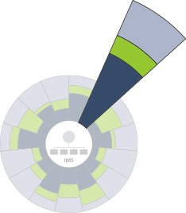

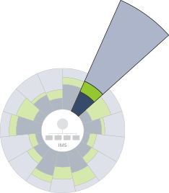
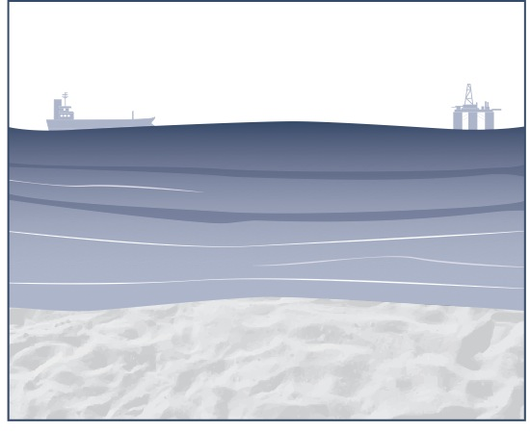
Examples of Appropriate Resource Capacity
  At each location, factors may exist which influence the ability to cascade resources and, therefore, require tailored capacities for each response capability.
example: offshore surface dispersant capability
location
factors
dispersant response
A remote location in a country with access challenges and/or severe weather
Greater local capacity due to limitations of external resources entering the country
A coastal location adjacent to a Tier 3 response center
Greater external support due to ease of access and proximity to Tier 3 response center
Notes:
Talking Points
Location factors, amongst many others, must be taken into account when provisioning resources based on the principles of Tiered Preparedness and Response.

Slide 12
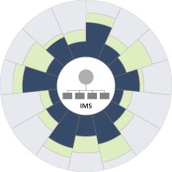
Tier 1 Description
Tier 1:
Resources necessary to handle a local spill and/or provide an initial response
while most resources are locally available, the size of the incident should not constrain the use of additional support (typically Tier 2 or Tier 3 organizations) where beneficial
*
Responders
Additional Support
Trained response staff on-site and available for emergencies in addition to their normal duties
Local contractors trained in oil spill response
Some elements of Tier 1 capability may not be kept permanently on-site, but are readily available at the time of need, such as:
  Non-specialized equipment, e.g., waste skips, storage trucks, personnel transport, etc.
  Support/infrastructure elements, e.g., additional security, accommodations, etc.
  Technical advice and/or specialized resources
Equipment
EXAMPLE SCENARIOS
An oil spill that requires Tier 1 capabilities for response is one related to operational activities at a fixed location, such as:
The overfilling of a tank
A leaking valve
A transfer hose or pipeline rupture
On-site or locally available with arrangements in place for rapid and effective mobilization
Amount and type is commensurate with risk, including location factors (e.g., weather, seasonality, or logistical constraints due to remote geographies)
Deployment times and methodologies are often predetermined
Supporting logistics provided
Notes:
Talking Points
Tier 1 resources are those appropriate for spills related to operational activities at a fixed location and are locally available and generally found on-site.
Tier 1 resources may also be used to provide an initial response for a significant spill.

Slide 13
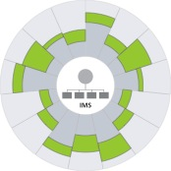
Tier 2 Description
Tier 2:
National or regional resources necessary to supplement a Tier 1 response
Responders
Additional Support
Dedicated response staff and additional responders provided by mutual aid agreements
Locally sourced workforce may be supervised by the Tier 2 provider
Designated oil spill response cooperatives
Specialized Tier 3 services
Cooperation at the local/regional government level
Network of additional responders
Equipment
EXAMPLE SCENARIOS
An oil spill that requires Tier 2 capabilities for response is one that has grown in severity or extended beyond Tier 1 capabilities, such as:
A ruptured pipeline in difficult terrain
A spill that crosses regional boundaries and requires the involvement of additional parties
Tier 1 resources used to mount an initial response, and industry’s response toolbox, including:
  Dispersant capabilities
  At-sea containment and recovery equipment
  Protection booms
  Shoreline and inland cleanup equipment
  Recovered oil storage capabilities
Amount and type appropriate for potential scenarios
Notes:
Talking Points
Tier 2 resources are external, either to the incident location or to the operating organization, and are used as a supplement for a spill that has extended beyond Tier 1 capabilities.
Tier 2 and Tier 3 resources are both comprised of the capabilities of our response toolbox. However, the quantity and capacity of those capabilities differentiates the tiers, as they are more limited in Tier 2.

Slide 14
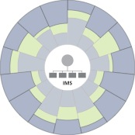
Tier 3 Description
Tier 3:
Global resources necessary for spills that require a substantial additional response due to incident scale, complexity, and/or impact potential
Responders
Additional Support
Dedicated response staff equipped with specialized skills
Tier 3 responders integrate with local and Tier 2 responders at all levels, including the response management structure
Dedicated industry Tier 3 response centers
Governmental or cooperative Tier 3 capabilities
Network of additional expert responders
Equipment
EXAMPLE SCENARIOS
An oil spill that requires Tier 3 capabilities for response is one that necessitates a wide range of available resources, such as:
A tanker suffering damage to its cargo tanks and releasing oil that could affect a large expanse of coastline
An accidental discharge of a relatively modest volume of oil in an ecologically sensitive location
Tier 1 and Tier 2 resources used to mount an initial response, and industry’s global response toolbox, including:
  High-volume aerial and subsea dispersant capabilities
  Large-scale containment and recovery equipment
  Protection booms
  In-situ burning capabilities
  Specialized shoreline and inland cleanup equipment
  Oiled wildlife response capabilities
  Logistics capabilities
Amount and type appropriate for potential scenarios
Notes:
Talking Points
Tier 3 resources are those used for significant spills, in scale and/or impact potential, that require a substantial external response.
Tier 2 and Tier 3 resources are both comprised of the capabilities of our response toolbox. However, the quantity and capacity of those capabilities differentiates the tiers, as they are more substantial in Tier 3.

Slide 15
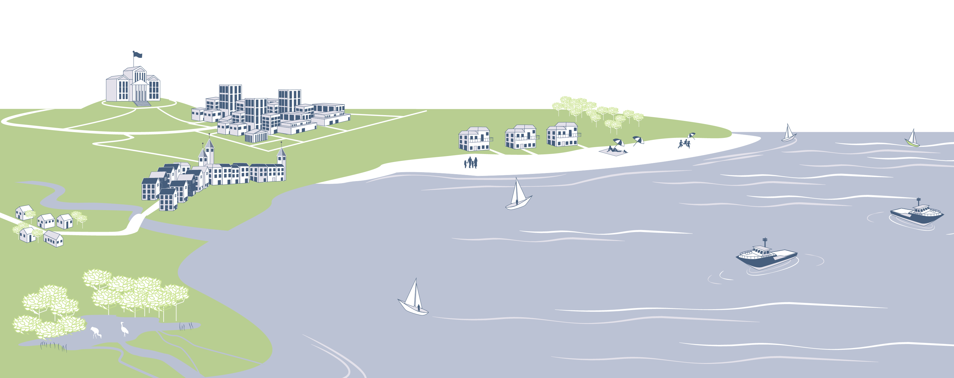
Summary
The principles of Tiered Preparedness and Response incorporate global resources for response escalation in order to respond effectively to a spill of any magnitude and protect our shared values.
Sensitive Ecosystems
Local Businesses
Health and Safety
Tourism/Recreation
Community Industries
Notes:
Talking Points
Industry’s principles of Tiered Preparedness and Response allow us to incorporate regional and global resources into response planning. These principles also enable industry to prepare for rapid response escalation in the unlikely event of an oil spill in order to protect our shared values.

