Slide 1
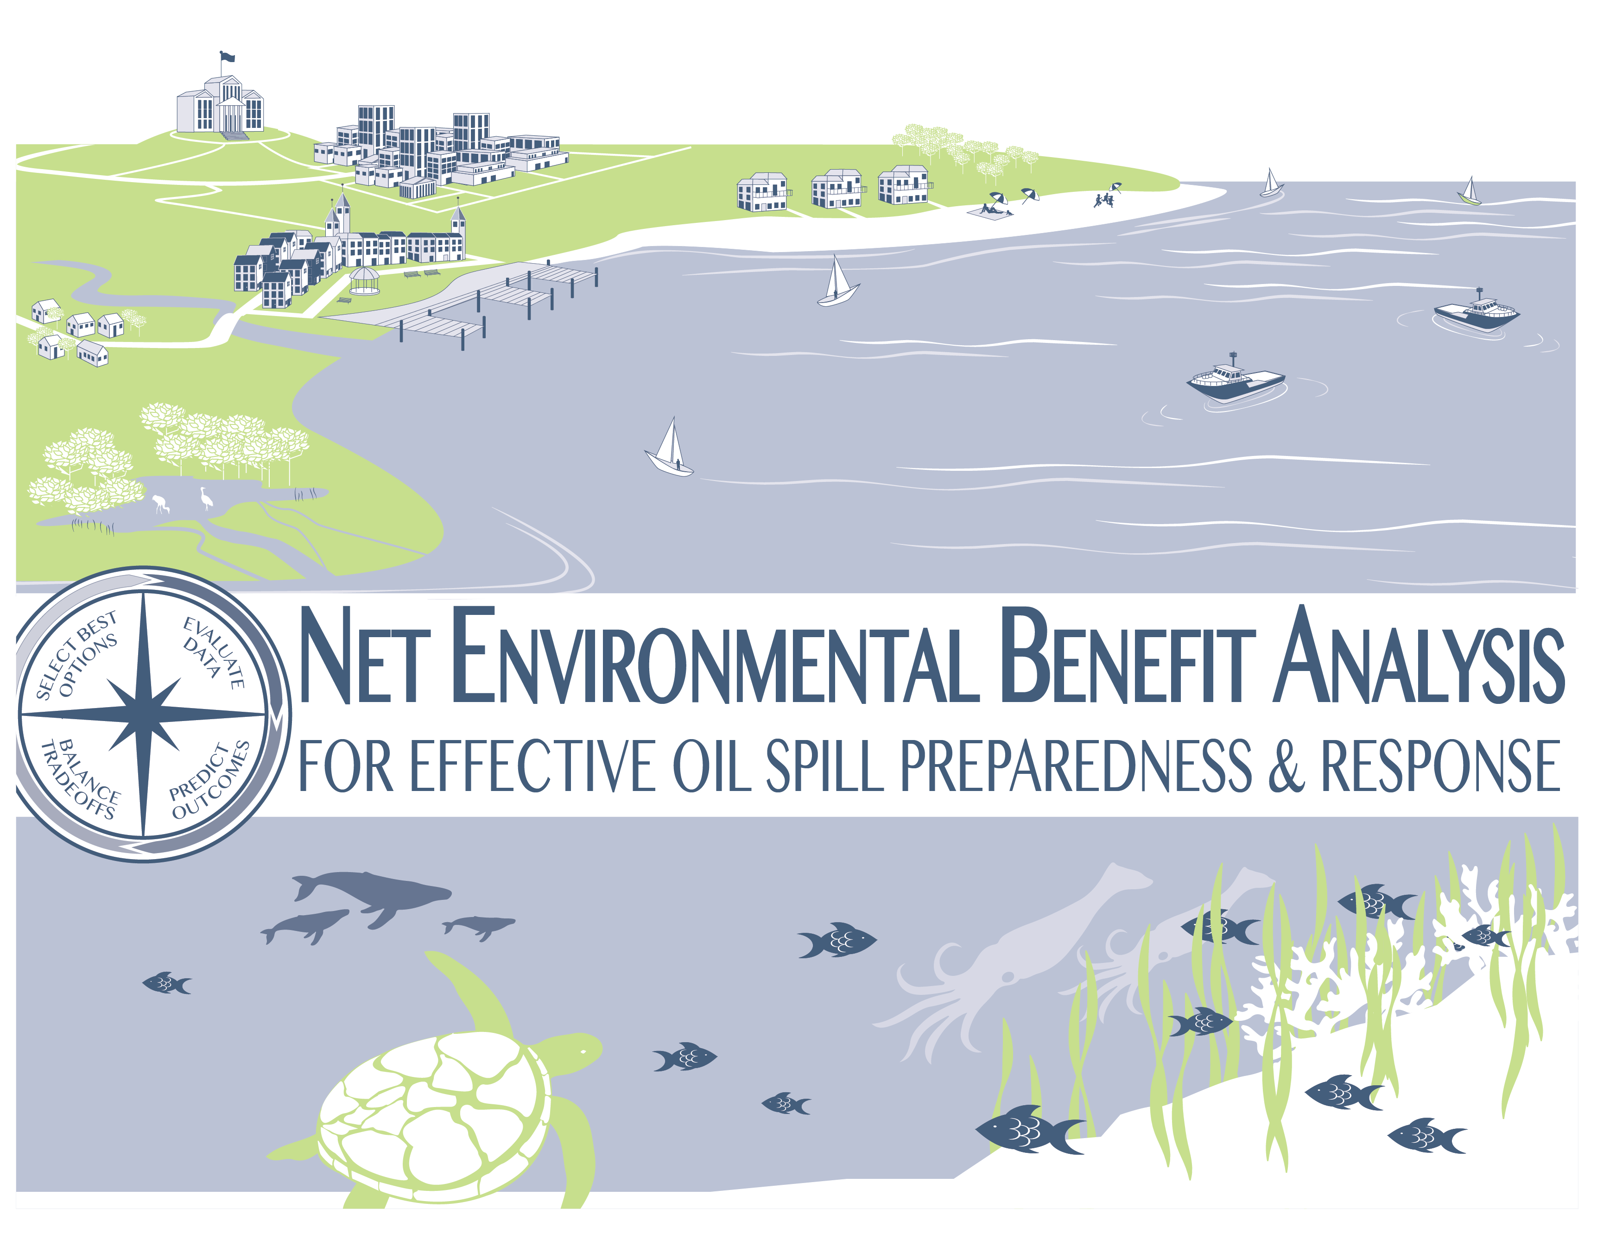

Notes:
Talking Points:
You may have never heard of Net Environmental Benefit Analysis, or NEBA, but it is one critical process used across the oil industry in preparing for and responding to oil spills.
Today, we’re going to talk about it in a bit more detail to show you why it’s so important…

Slide 2
Our Goal Is to Prevent Spills Entirely
Our goal is to never have an oil spill, and the industry takes extensive precautions to prevent spills from occurring.
Notes:
Talking Points:
As we discuss NEBA, we want to also emphasize that our focus is prevention, and significant resources are dedicated to prevent a spill from occurring. Industry constantly incorporates new research, understanding, and lessons learned to improve spill prevention.
Number of spill incidents per decade has gone from 246 in the 1970s to 33 in the 2000s (Source: International Tanker Owners Pollution Federation (ITOPF))
Amount of oil spilled has decreased from 1,135,000 tonnes in the 1970s to 212,000 tonnes in the 2000s (Source: ITPOF)
However, in the unlikely event that there is a spill…

Slide 3
Topics For Discussion
What are our primary goals and values?
What is Net Environmental Benefit Analysis (NEBA)?
How is NEBA used during the entire oil spill preparedness and response process?
How can you support effective use of NEBA to minimize impact on the environment and communities?
Notes:
Talking Points:
What we would specifically like to emphasize today is how NEBA is used as a proactive process for minimizing impact on the environment and our society.
To do that, we will first talk about how we work together with policymakers and local communities to protect our shared values.
We will also define and provide a visual depiction of NEBA within the context of effective oil spill response so you can get a sense of how it works.
And then, we will talk about practical ways in which we can apply NEBA – and how we can work together to make NEBA effective for our environment and our communities.

Slide 4

Protecting Our Shared Values
  We follow a set of guiding principles that allow the response community to protect our shared values.
Sensitive Ecosystems
Local Businesses
Health and Safety
Tourism/Recreation
Community Industries
Notes:
Talking Points:
In the rare event that an oil spill does occur, industry’s goal is to minimize the impact of the spill to people, environments, and communities, and ensure the most rapid response.
Industry and government have a shared interest in a unified, coordinated, and proactive approach, as this allows us to protect our shared values, which include:
Sensitive ecosystems,
The local business community and economy,
The health and safety of our citizens, and
The vitality and sustainability of tourism and other key community industries such as fishing.
To achieve this well-managed response, there are several guiding principles that industry follows. These principles are meant to support the protection of our most critical environmental and community assets.
Our guiding principles include:
We prioritize the health and safety of people,
We stop the source of a spill as quickly as possible,
We minimize environmental and community impact,
We prevent oil from getting to shore in offshore scenarios, and
We prevent oil from getting into the water in onshore scenarios.

Slide 5
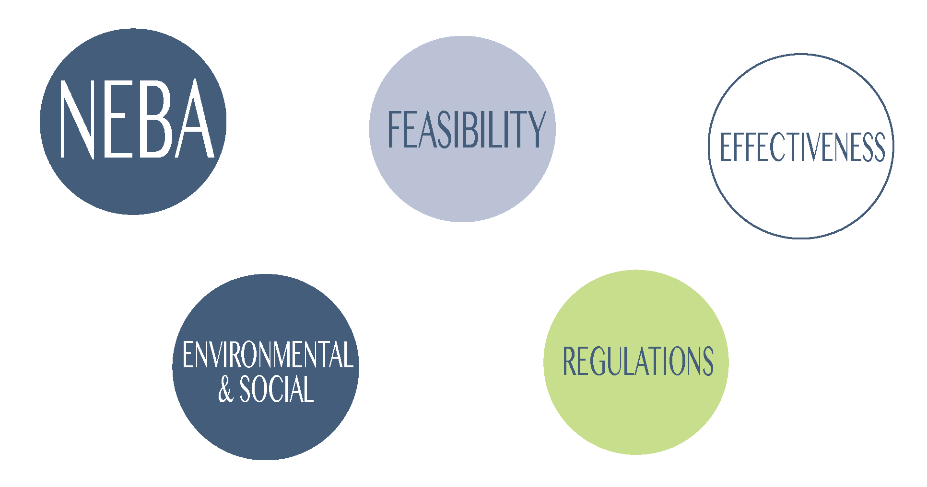
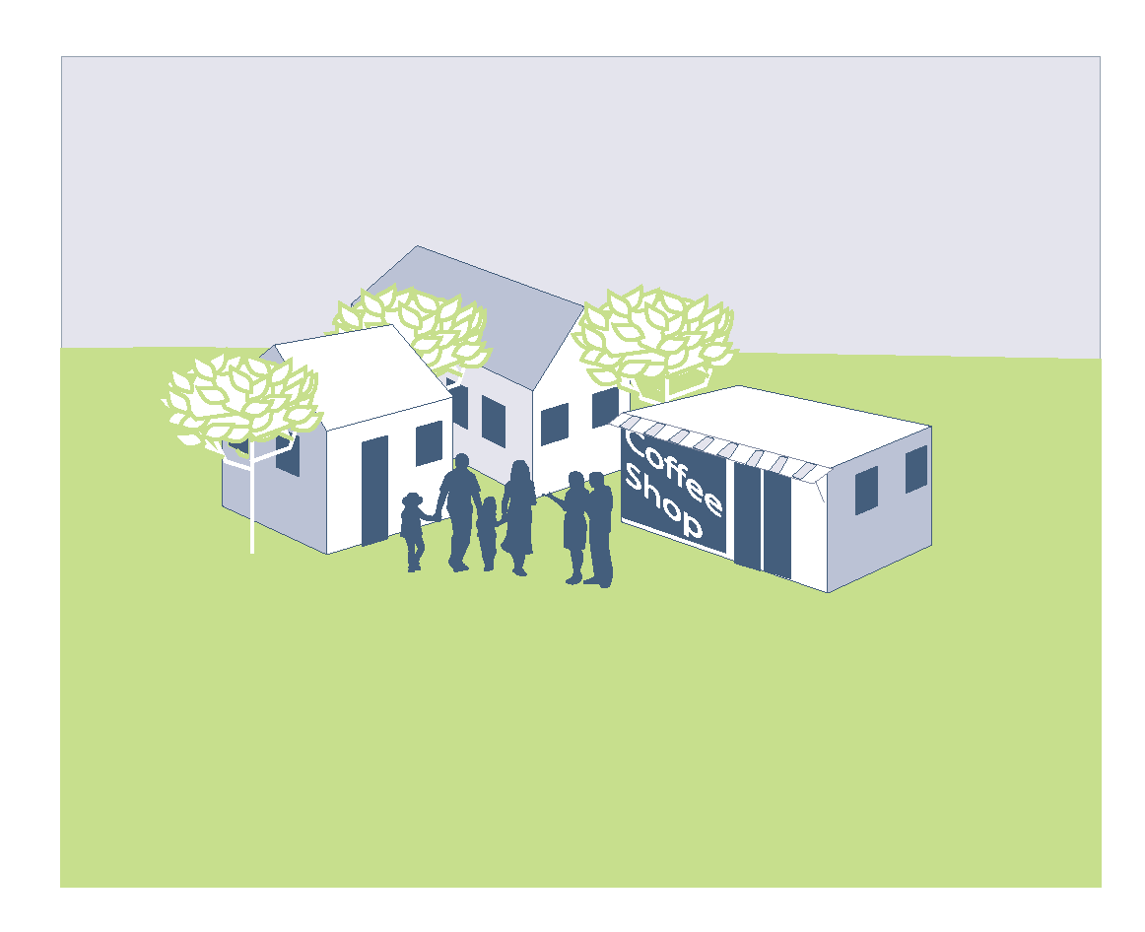
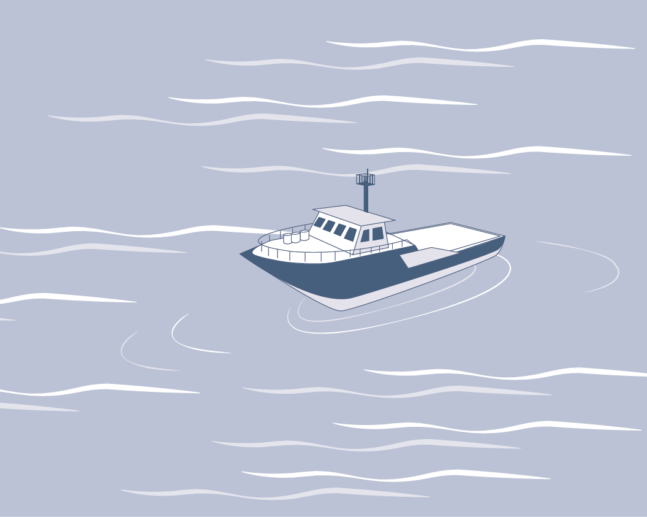


NEBA Helps Protect People and the Environment
Net Environmental Benefit Analysis (NEBA) is a process used by the response community for making the best choices to minimize impacts of oil spills on people and the environment.
Through the use of NEBA, the response community strives to protect shared values and community assets with every operational decision.
Notes:
Talking Points:
NEBA plays a critical role in protecting these shared values. The NEBA process is used through every stage of oil spill preparedness and response – before a spill, during a spill, and after a spill.
What is NEBA? It is a process used by the response community for making the best choices to minimize impacts of oil spills on people and the environment.

Slide 6










We Engage with Diverse Stakeholders
Coordination between governments, industry, and communities before, during, and after a spill facilitates the least possible impact to the environment and community resources.
Local, Regional, and National Government Administrations
Preparedness and Response Community
Open Lines of Communication
Transparent Decision-Making
Clarification of Policy
Realistic Expectations
Community Members
Responsible Party
Government Entities
Potentially Impacted Stakeholders
Potentially Affected Community
Scientific Experts
Media
Notes:
Talking Points:
There are many stakeholders involved in oil spill response and the use of NEBA. What’s most critical is that there is solid coordination between governments, industry, and communities before, during, and after a spill to facilitate understanding and access to all the tools in the response toolbox.
There are two distinct groups involved in oil spill response: the first is the actual response community, who is responsible for managing any efforts related to a spill. The second is the larger community that is impacted or involved with the oil spill.
Who is involved in the response community? This group includes the responsible party, government entities, potentially impacted stakeholders and communities, and scientific experts.
Who does the response community interact with for communication around a spill? This group includes local, regional, and national government administrations, community members, and the media.
For successful oil spill preparedness and response, the interaction between these two groups must consist of open lines of communication, transparent decision-making, clarification of policies, and realistic expectations of response outcomes.

Slide 7
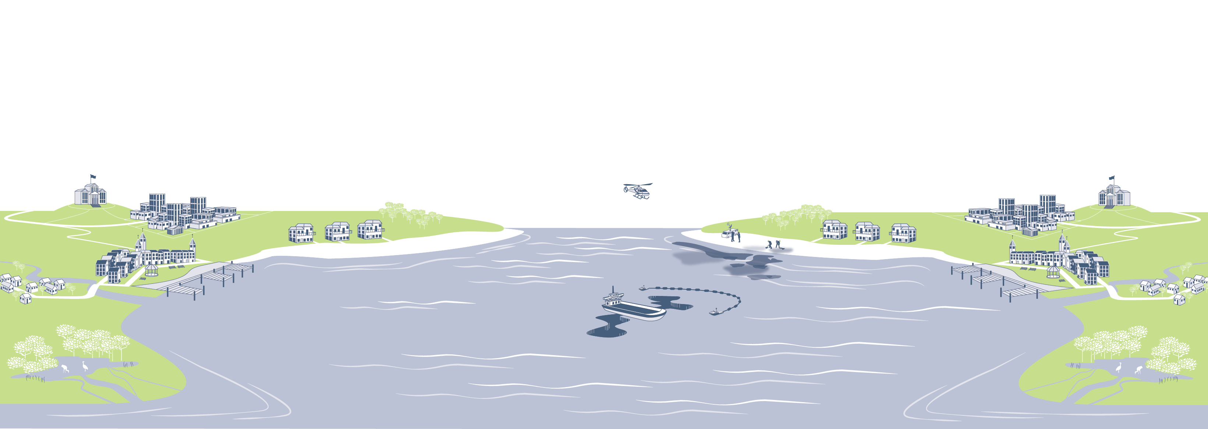
Our Oil Spill Preparedness and Response Framework
Before
During
After
Communication &
Monitoring
Plan: Develop plans based on potential scenarios
Assess: Identify and prioritize environmental and community assets and review previous spill cases
Decide: Select the most effective response approach based upon priorities and tradeoffs
Deploy: Rapidly implement response based on pre-planning
Evaluate: Assess current conditions and response
Adapt: Modify response approach as conditions continue to evolve
Restore: Work with communities and governments to restore the environment and community assets to pre-spill use
Learn: Gather and incorporate lessons learned into future policies, plans, and good practice guides
Notes:
Talking Points:
Now we’d like to talk about our framework for preparing and responding to an incident through the lens of before, during, and after a spill.
Before an incident, it is critical that we develop contingency plans based on identified potential scenarios. It is also important that we accurately assess both environmental and community assets in order to decide on the most appropriate approach to enable an effective and rapid response.
During a spill, we rapidly deploy our response based on our pre-planned scenarios. Throughout the response, we are constantly evaluating the response effort as well as the evolving conditions, adapting our approach as necessary in order to continually pursue the most effective response strategy.
After the spill and the immediate response effort, we assess the impact to natural resources and the local economies in order to restore the environment and community to pre-spill conditions. We also improve our future policies, plans, and good practice guides based on lessons learned from the event.
Throughout the entire oil spill response process, we place a high level of importance upon communicating with local communities and providing transparency into the response effort.

Slide 8


Our Navigational Guide for Selecting Response Tools
We have a defined process and consider four primary factors at varying points when selecting response tools:
Factors
Effectiveness:
Which tools will achieve the desired results?
Feasibility:
Which tools can be realistically and safely used?
Net Environmental
Benefit Analysis:
Which tools will minimize impact on the environment and the community?
Regulations:
Which tools are addressed in the regulatory framework?
Notes:
Talking Points:
Let’s take a deeper dive into how we select our oil spill response capabilities. For each scenario, we use a four step process as a guide to select our response tools. The four steps are: evaluate data, predict outcomes, balance tradeoffs, and select best options.
We consider four primary factors along the navigational guide in informing response tool selection.
First, we consider effectiveness. For example, “which tools will achieve the desired results?”
Then, we consider feasibility. This may include questions like “which tools can be realistically and safely executed?”
Then, we consider NEBA. In this process, we ask questions like “which tools will minimize impact on the environment and the community?”
Last, we consider regulations. For example, “which tools are addressed in the regulatory framework?”

Slide 9


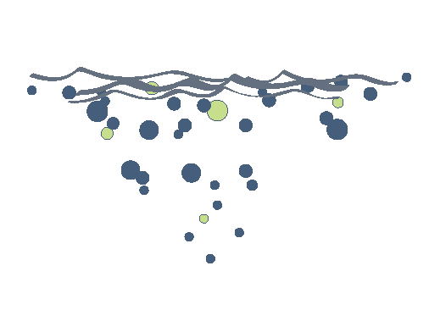



Preparing for Potential Oil Spills
We are prepared for the unlikely event of a spill, with strategies and tools to respond to potential scenarios.
Potential spill scenarios
Onshore
Inland
Subsea
Near Shore
Offshore
Response tools
When a spill occurs, source control is immediately applied – after which, response tools are implemented.
Dispersants
In-Situ Burning
Mechanical Recovery
Physical Removal
Natural Processes
Notes:
Talking Points:
Let’s take a look at how the response community effectively prepares for and responds to oil spills.
Oil is a critical resource and accessing it and shipping it involves some level of risk.
As an industry we are always proactively preparing with the rest of the response community in case of an oil spill by:
Identifying potential scenarios for a region, and
Conducting drills and exercises to identify the most effective tools to use in those scenarios. Those response tools include natural processes, mechanical recovery, dispersants, in-situ burning, and physical removal.
We are also continuously improving our response capabilities through lessons learned, scientific study, and collaboration with the scientific community.

Slide 10
NEBA and Our Navigational Guide
Our navigational guide is used throughout the NEBA process to select the best response choices that minimize impacts of oil spills on people and the environment.
Notes:
Talking Points:
Now let’s look specifically at how we use the NEBA process to affect our response choice selection.

Slide 11
Evaluating Data
In NEBA, the response community identifies and prioritizes a community’s most critical environmental and social variables.
Environmental and Social Variables
Local Populations
Cultural and Historical Considerations
Sensitive Species
Recreational Activities
Ecologically Sensitive Areas
Critical Infrastructure
Local and Community Industries
Seasonal Variables
Notes:
Talking Points:
Before a spill, we use NEBA to evaluate data on the most important environmental and community assets.
This part of the NEBA analysis includes questions like:
What is the proximity to populations?
Are sensitive species present? If so, what kinds?
What is the spill’s proximity to ecologically sensitive areas?
What are the community’s most important industries?
What critical infrastructure must we consider?
What cultural and historical considerations influence our response?
What recreational activities will be impacted?
What are the seasonal variables?
The answers to these questions and others are foundational to how we analyze and plan for an incident, even before it occurs.

Slide 12

Predicting Outcomes
The response community uses planning scenarios to evaluate the full range of potential impacts and response options for specific locations.
Potential
Impacts
Planning
Scenarios
Possible Response Options
When planning scenarios, source control as the initial response is taken into consideration.
Notes:
Talking Points:
NEBA is used to predict outcomes in order to inform response tool selection.
The response community uses previously developed planning scenarios to analyze and evaluate oil spill models and simulations, based on our experience and scientific expertise. These evaluations allow responders to predict potential impacts and predetermine the most appropriate and effective response tools.

Slide 13
Balancing Tradeoffs
When a spill occurs, source control is immediately applied – after which, response tools are implemented.
 | Benefits | Drawbacks
 | Removes surface oil that could harm wildlife and keeps oil from spreading to shoreline; enhances natural biodegradation of oil and reduces vapors on water surface | Dispersed oil has the potential to initially affect local water column-dwelling wildlife and vegetation
 | Removes oil with minimal environmental impact | Mechanical recovery can be inefficient, resource-intensive, and restricted by water conditions, with typically no more than 10-20 percent oil recovery
 | Removes large amounts of oil rapidly via controlled burning | Burning presents a potential safety risk and localized reduction of air quality; burn residue can be difficult to recover
 | Selectively restores environmental and social value to specific locations using a variety of tools | Aggressive or inappropriate removal methods may impact ecosystems and individual organisms
 | Takes advantage of natural processes for oil removal, including biodegradation, and avoids intrusive cleanup techniques that may further damage the environment | Natural removal can take more time to achieve pre-spill use than other response techniques
Dispersants
Mechanical Recovery
In-Situ
Burning
Physical Removal
Natural Processes
Notes:
Talking Points:
The NEBA process then weighs social and environmental considerations to balance tradeoffs in pre-selecting response tool options.
Our response toolbox is equipped with capabilities that allow us to respond with speed and effectiveness. Dispersants, in-situ burning, mechanical recovery, physical removal, and natural processes are all a part of industry and government’s response toolbox.
Let’s talk a bit more about how these tools are selected and deployed.

Slide 14

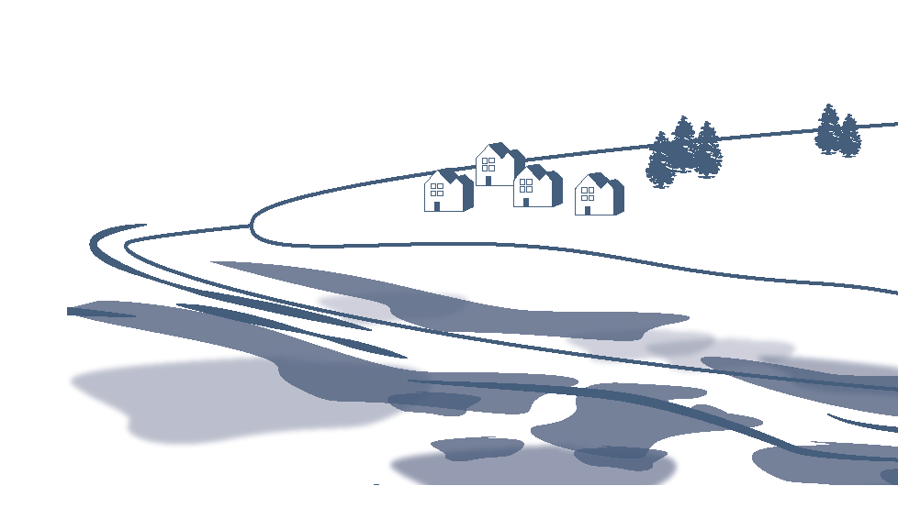

Pre-Selecting Options
When pre-selecting options, source control as the initial response is taken into consideration.
Example Scenarios
Possible Response Tools
Offshore Release
tanker spill
Dispersants
Mechanical
Recovery
In-Situ
Burning
Physical
Removal
Natural
Processes
Offshore Release
subsea spill
Offshore Release
spill flowing towards populated area
Near Shore Release
spawning season
Onshore or Near Shore Release
near marsh or sand beach
Notes:
Talking Points:
Through detailed assessments, the NEBA process supports plans and pre-approvals for appropriate pre-selection of response tools. Additionally, spills can change over time; therefore, they are continually assessed using NEBA, and the response tool may change based on the updated situation.
NOTE TO PRESENTER: This is a good opportunity to introduce what happens when the wrong tools are selected (e.g., near shore trampling of vegetation if using physical removal in wrong areas, oil getting nearer to shore without use of dispersants, etc.).
Analogy: A doctor doesn’t give patients drugs before a discussion – he assesses symptoms first.
Analogy: A construction worker wouldn’t use a bulldozer for work that requires a shovel.
Understanding the specific needs of vastly different environments, we use tools that are targeted for each scenario and based on the assessment of factors and variables mentioned earlier.

Slide 15

What Role Does NEBA Play Before a Spill?
Before
Response Tool Selection Process
Evaluate Data
Predict Outcomes
Balance Tradeoffs
Select Options
Identify and prioritize environmental and community assets based on environmental sensitivities and social values
Use planning scenarios to assess potential impacts and response options for specific locations
Weigh environmental and social impacts to determine the most effective oil spill response tools and to balance tradeoffs
Establish response plans and pre-approvals to support environmental and social values
Notes:
Talking Points:
Now let’s look at how exactly NEBA is used before, during, and after a spill.
NEBA is used before an event to develop the most effective response plan based on potential scenarios, which includes the pre-selection of tools. In this manner, the use of NEBA enables a speedy response and protects key environmental and community assets.
Lessons learned from previous oil spills are incorporated to inform preparedness efforts before an event.

Slide 16
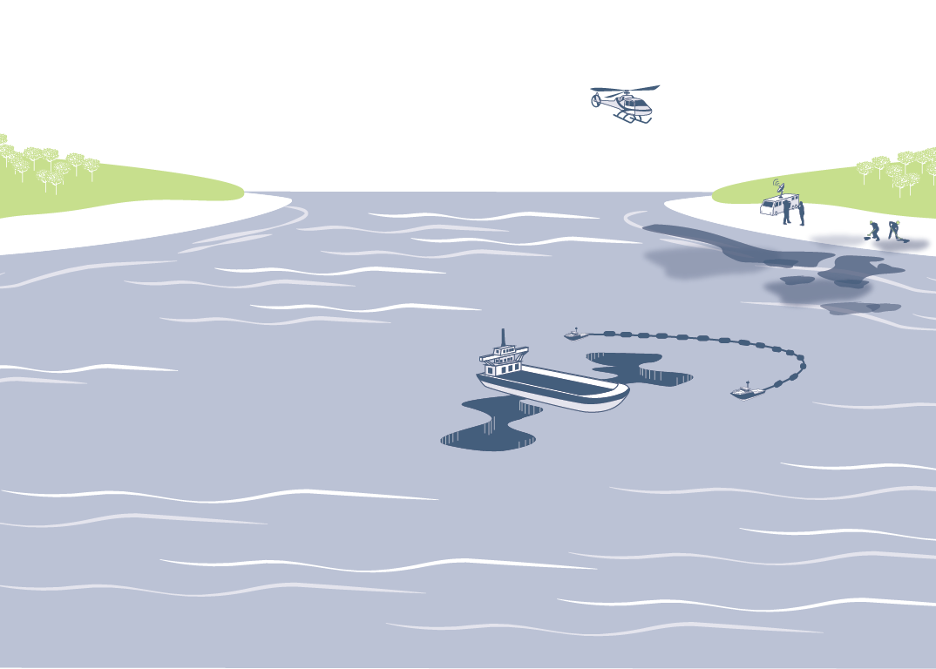
What Role Does NEBA Play During a Spill?
During
Response Tool Selection Process
Evaluate Data
Predict Outcomes
Balance Tradeoffs
Select Options
Engage stakeholders to assess spill- and site-specific conditions and anticipated impacts
Confirm effectiveness and feasibility of pre-planned response options to achieve optimal results
Re-evaluate and adapt response to address evolving conditions
Facilitate rapid decision-making and adaptation of oil spill response based on ongoing evaluations
Notes:
Talking Points:
Now let’s talk about what happens during an actual event. The response community uses NEBA to validate tool selection and, where needed, adapt response activities to changing conditions. For example, responders may assess environmental sensitivities in light of changing wind conditions. As a result, they may select a modified response approach or tool to minimize impacts.
NEBA is constantly being used throughout a response effort in order to evaluate the benefit of the current response effort. At each evaluation point, responders will determine the impact of the response on the environment. The results of these evaluations will inform responders when and where to ramp up the response effort (e.g., a larger response will produce a significant benefit), when to slow it down (e.g., the response effort is producing diminishing returns and is reoriented to another area), and when to stop it altogether (e.g., further response will do more harm than good to the environment).
Experience and lessons from previous spills are also taken into account and incorporated into decision-making during a response.

Slide 17

What Role Does NEBA Play After a Spill?
After
Response Tool Selection Process
Evaluate Data
Predict Outcomes
Balance Tradeoffs
Select Options
Confirm site-specific conditions and impacts after response
Identify restoration options and what they may achieve
Engage stakeholders to determine the most effective restoration activities
Perform restoration activities until agreed-upon endpoints are achieved
Notes:
Talking Points:
After an event, NEBA is used again to inform the appropriate selection of restoration activities and to improve future response efforts through data collection, lessons learned, and the evaluation of environmental and social impacts.
If the NEBA process is used effectively before and during an oil spill – and if the response process is unified, timely, and well-managed – the impact and the amount of effort required to minimize impact is lessened.
Now let’s look at the keys to effective collaboration and coordination throughout the oil spill preparedness and response process.

Slide 18


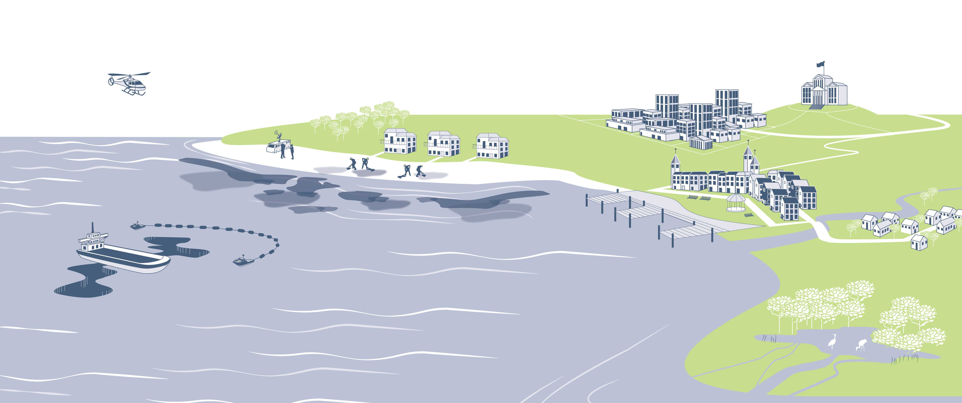
Industry, Government, and Community Coordination is Key
A well-managed response includes:
Safety at the forefront of response decisions
Use of NEBA and consideration of tradeoffs in response decisions
Availability of appropriate response equipment and tools
Governments and industry working together in response
Effective and timely stakeholder engagement
Notes:
Talking Points:
Coordinated efforts protect people, the environment, and critical community assets and enable more effective restoration efforts. A well-managed response includes:
Safety at the forefront (for example, protective gear in use and other considerations for worker safety),
NEBA used and tradeoffs considered for both the long-term and short-term impacts,
All appropriate equipment available,
Government and industry working together in response (as appropriate), and
Most importantly, a well-managed response requires effective, timely communication with government, industry, and the local community.
NOTE TO PRESENTER: The speaker may want to distinguish a well-managed response from a poorly managed response, e.g., short-sighted responses; knee-jerk reactions based on political pressures; destruction of marshes or beaches due to inappropriate use of physical/mechanical removal techniques.

Slide 19
How Can You Support Oil Spill Preparedness and Response?
Our shared goal is to preserve human life, the environment, and community well-being during oil spill response.
Every government and community member can help us in achieving our goal of a rapid and unified response.
Work with us before a spill, participating in conversations with industry on a regular basis.
Join us for drills and exercises in your community.
Support our efforts to put plans and pre-approvals in place before a spill.
Through effective preparation, we can create a more rapid and efficient response together.
Notes:
Talking Points:
Industry and government should continue to coordinate on this important issue. Our success in effectively using NEBA in oil spill preparedness and response relies on cross industry-government cooperation. Our shared goal is to preserve human life, the environment, and community well-being during times of spills.
You can help by:
Learning the facts about NEBA and oil spill preparedness and response,
Sharing what you know with others,
Developing policies and plans that enable safe and speedy response, and
Supporting the response decision-making processes.

Slide 20
APPENDIX

Slide 21
NEBA in Action: Subsea Spill
Subsea Dispersant Application:
In this scenario, subsea dispersant application is probably the most effective selection. Dispersants break down oil slicks at the source of the leak, promoting rapid biodegradation and minimizing oil reaching the surface.
Dispersants
Oil Removal Over Time
Time
Notes:
Talking Points:
In this scenario, you can see how the NEBA process is used to determine how best to prevent a subsea spill from making it to the water surface and, eventually, to the shore.
In this case, responders leverage their understanding of oil removal over time in specific environmental circumstances to guide their decision-making. Their perspective comes from past spill histories and an in-depth knowledge of the environment – as well as an intimate understanding of the specific weather and geographic conditions.
Comparing these conditions and knowledge to human and environmental factors, responders use the NEBA process to guide their tool selection.

Slide 22


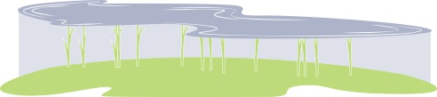
NEBA in Action: Oil Release in Wetland Area
In-Situ Burning:
In this scenario,
in-situ burning may be the most effective option because it will remove the oil from the surface without harming the root system of the wetland vegetation.
Oil Removal Over Time
Time
Notes:
Talking Points:
In another scenario, the NEBA process is used to evaluate the specific factors of an oil release in a wetland, or marsh, area.
In keeping with the guiding principles for an oil spill in an onshore location – and prioritizing the environmental sensitivities of a wetland – the responders would select in-situ burning. While seemingly counterintuitive, the burning actually removes oil at the surface level, protecting the valuable root system that will allow natural regrowth in the area.
It is crucial that responders select the right tools so that additional, long-term environmental damage is avoided. Conducting NEBA before an event and pre-selection of tools allows this kind of rapid decision-making during an incident.

Slide 23
Understanding Oil Spill Response
Responders carefully apply decision frameworks, considering the significant tradeoffs involved in response.
Inherent limitations exist in the amount of oil that can be recovered during any given response effort.
There will be negative side effects of spills, even when the most effective tool is chosen.
Government, communities, and industry must assess potential spill impacts and make decisions together.
Access to appropriate response tools is critical for successful response.
Notes:
Talking Points:
NOTE TO PRESENTER: For all “Appendix” slides, it is at your discretion how and when to use, if at all.

Slide 24
Our Response Toolbox
When a spill occurs, source control is immediately applied – after which, response tools are implemented.
Response Toolbox | Benefits | Drawbacks
 | High aerial coverage rate possible at the water surface High treatment efficiency possible subsea Large volumes of oil can be treated Potentially high oil elimination rate Reduced vapors at the water surface; improves safety No recovered oil storage requirements Lower manpower requirements Potentially the quickest response option Prevents oil from spreading to shoreline Useful in higher wind and sea conditions Effective over wide range of oil types and conditions | Special approvals required Less known about long term effects of subsea use Perceived to be unsuitable for calm seas Short-term, localized reduction in water quality Potential impact on water column ecology Specialized equipment and expertise required Usage near shore in shallow water could result in greater water column impacts Will not work on high viscosity fuel oils in calm, cold seas Has a limited “window of opportunity” for use
 | Well-accepted, no special approvals needed Effective for recovery over wide range of spilled products Large “window of opportunity” Minimal side effects Greatest availability of equipment and expertise Recovered product may be reprocessed | Inefficient and impractical on thin slicks Ineffective in inclement weather or high seas Requires storage capability Typically recovers no more than 10-20 percent of the oil spilled Labor- and equipment-intensive
 | High oil elimination rate possible No recovered oil storage requirements (except possibly for burn residue) Effective over wide range of oil types and conditions Specialized equipment (boom) is air transportable Minimal environmental impact | Special approvals required Ineffective in inclement weather or high seas Black smoke perceived as significant impact on people and the atmosphere Localized reduction of air quality Specialized equipment and expertise required Potential for secondary fires during inland use Burn residue can be difficult to recover
 | Non-aggressive methods can have minimal impact on shore structure and shore organisms Useful for detailed cleaning of near shore environment in specific or sensitive areas | Aggressive removal methods may impact shoreline and shore organisms (e.g., sand removal and cleaning) Potential for heavy equipment and high foot traffic (trampling) can cause additional environmental damage Removal occurs after oil has already impacted shore Labor-intensive
 | No intrusive removal or cleanup techniques that further damage the environment Complements other response techniques May be best option if there is little to no threat to human or environmental well-being When selected for certain areas and conditions, the environment can recover from the spill more effectively than it might when using other response tools | Winds and currents can change, sending the oil spill toward sensitive areas Residual oil can impact shoreline ecology, wildlife, and economically relevant resources Public perception that responders are doing nothing
Dispersants
Dispersants allow small oil droplets to form which speed up natural breakdown in the water column.
Mechanical Recovery
Mechanical recovery uses booms and skimmers to contain and remove oil from the water surface.
In-Situ Burning
In-situ burning involves igniting contained oil slicks.
Physical Removal
Physical removal consists of the physical removal of surface oil by crews with tools and machinery.
Natural Processes
Natural removal allows for more effective recovery in environments where intervention would be detrimental.
source: exxonmobil oil spill response guidelines

Slide 25
Tradeoffs of Dispersants
Response Decision: Dispersant Use
Benefits
Drawbacks
Reaches and treats significantly more oil than other response options
Can be applied over a broader range of weather conditions
Speeds up oil removal from the water column by enhancing natural biodegradation
Prevents oil in a subsea spill from surfacing, mitigating harm to sea birds, mammals, and other wildlife
Prevents oil from spreading to shoreline, reducing risk for sensitive shoreline vegetation and wildlife
Reduces impact on community assets and local industries
Does not directly collect the oil from the environment, but rather transfers it from the surface to the water column where it can be biodegraded
Potential effects of dispersed oil on water column-dwelling wildlife and vegetation (anticipate short-lived and localized exposures)
Will not work on high viscosity fuel oils in calm, cold seas
Has a limited “window of opportunity” for use
Potential impact to fishing industries due to public misunderstanding of dispersants’ effects on seafood
Notes:
Talking Points:
NOTE TO PRESENTER: For all “Appendix” slides, it is at your discretion how and when to use, if at all.
There are tradeoffs involved in most situations, and the goal of response teams is to achieve the best results with the least impact.
Dispersant use comes with benefits and tradeoffs that responders weigh as they make response decisions. During every spill response effort, our goal is to achieve the best results with the least impact.

Slide 26
Tradeoffs of Mechanical Recovery
Response Decision:
Mechanical Recovery
Benefits
Drawbacks
Removes oil with minimal environmental impact
Well-accepted, no special approvals needed
Effective for recovery over wide range of spilled products
Large “window of opportunity”
Minimal side effects
Greatest availability of equipment and expertise
Recovered product may be re-processed
Inherently inefficient and often very slow
Often cannot recover enough oil to prevent shoreline impact
Harder to recover a lot of oil in larger spill cases
Inefficient and impractical on thin slicks
Ineffective in inclement weather or high seas
Requires storage capability
Typically recovers no more than 10-20 percent of the oil spilled
Labor- and equipment-intensive
Notes:
Talking Points:
NOTE TO PRESENTER: For all “Appendix” slides, it is at your discretion how and when to use, if at all.
Mechanical recovery, traditionally used in many oil spill scenarios, may not always be most effective. It is labor-intensive and typically recovers no more than 10-20 percent of oil spilled. It can be used more effectively, as shown earlier in the subsea spill scenario, when in complement with other response tools.

Slide 27
Tradeoffs of In-Situ Burning
Response Decision:
In-Situ Burning
Benefits
Drawbacks
Rapid removal of large amounts of oil
Much less oil left for disposal
High efficiency rates (up to 98-99%)
Less equipment and labor required and specialized equipment (boom) is air transportable
May be only viable option (e.g., marshes, ice)
No recovered oil storage requirements (except possibly for burn residue)
Effective over wide range of oil types and conditions
Minimal environmental impact
Black smoke perceived as significant impact on people and the atmosphere
Limited “window of opportunity” for spills on open water (emulsified oils do not burn)
Burning presents a potential safety risk
Burn residue can be difficult to recover (may sink from burns of very heavy oils)
Special approvals required
Localized reduction of air quality
Potential for secondary fires during inland use
Notes:
Talking Points:
NOTE TO PRESENTER: For all “Appendix” slides, it is at your discretion how and when to use, if at all.
In-situ burning, with its high efficiency rate, can be used over a wide range of oil types and conditions. However, there is a limited “window of opportunity” for use and the public fears the risk of fire spreading. Use of the NEBA process allows responders to understand, assess, and balance these factors to make an optimal tool selection.

Slide 28
Tradeoffs of Physical Removal
Response Decision:
Physical Removal
Benefits
Drawbacks
Removes oil
Reduces potential for oil spreading further
Reduces secondary impacts to animals that come down to shorelines
Prevents remobilization of the oil
Non-aggressive methods can have minimal impact on shore structure and shore organisms
Useful for detailed cleaning of near shore environment in specific or sensitive areas
Further damage to environment: aggressive removal methods may impact shoreline and shore organisms (e.g., sand removal and cleaning)
Requires storage capability
Typically recovers no more than 10-20 percent of the oil spilled
Labor-intensive
Potential for heavy equipment and high foot traffic (trampling) can cause additional environmental damage
Removal occurs after oil has already impacted shore
Notes:
Talking Points:
NOTE TO PRESENTER: For all “Appendix” slides, it is at your discretion how and when to use, if at all.
Like mechanical recovery, physical recovery is often perceived as one of the preferred mechanisms for oil removal. However, also like mechanical recovery, physical recovery rates of oil removal are between 10 to 20 percent in a highly labor-intensive process. When used in complement to other tools, physical recovery oil removal rates increase.

Slide 29
Tradeoffs of Natural Removal
Response Decision:
Natural Processes
Benefits
Drawbacks
No intrusive removal or cleanup techniques that could further damage the environment
Complements other response techniques
Observations and data gained from monitoring inform response decisions and tool selection
May be best option if there is little to no threat to human or environmental well-being
When used in certain areas and conditions, the environment can recover from the spill more effectively than it might when using other response tools
Not removing the oil
Winds and currents can change, sending the oil spill toward sensitive areas
Residual oil can impact shoreline ecology, wildlife, and economically relevant resources
Public perception that responders are doing nothing
Notes:
Talking Points:
NOTE TO PRESENTER: For all “Appendix” slides, it is at your discretion how and when to use, if at all.
Natural removal complements other response tools and techniques. Depending on the weather conditions and threat to human and environmental well-being, natural removal could be the most effective option.

Slide 30
How Can You Support a Rapid And Unified Oil Spill Response?
www.oilspillinfo.org
www.ipieca.org
www.oilspillresponseproject.org
Learn
the facts about oil spill response.
what you know about oil spill response with others.
Share
  Develop
policies and plans that enable safe and speedy response.
the appropriate use of all viable response tools.
Support
Notes:
Talking Points:
NOTE TO PRESENTER: For all “Appendix” slides, it is at your discretion how and when to use, if at all.
Industry and government should be coordinated on this issue. Our success in effectively using NEBA in oil spill response relies on cross industry-government partnerships and alignment. Our shared goal is to preserve human life, the environment, and community well-being during times of spills.
You can help by:
Learning the facts about NEBA and oil spill response,
Sharing what you know with others,
Developing policies and plans that enable safe and speedy response, and
Supporting the response decision-making processes.

